Slide 1
Game Activity and Player Performance Logging IGGI Games Design II
Simon Lucas, Diego Perez
and Jialin Liu

Slide 2
Metrics for Game Design
The main aim is to foster a way of thinking about game design
What aspects of game-play can be usefully measured in objective ways
And inform game design
Results used to:
Say something interesting about the game play
Decide whether games are noticeably differrent in terms of the player activity and game logs
Provide objective functions for automated game tuning

Slide 3
Terminology
We’ll mostly avoid using subjective terms
Such as fun, or player experience
Instead the emphasis will be on objective measures
Game Activity:
Everything that happens in the game
Player Activity:
The actions taken by a player
Game metric:
Turning what happens in the game into numbers
Player performance:
This measures how well individual players do in the game
The players could be human or bots

Slide 4
Player Experience
By contrast with the above objective measures, player experience can be subjective – depending on what aspects of the experience we are talking about
This can be measured for human players for for bots

Slide 5
Why Measure Player Experience?
To learn about human behaviour
To categorise players depending on their behaviour
Predict player actions
Estimate player engagement (and predict when they are about to disengage)
To learn more about the game
And understand differences in variations of a game (is version A better than version B?)
Does a game have defects / exploits?

Slide 6
Player Experience for Game Design: Is it necessary to measure it?
No, not necessary (depending on ambition and budget you have for a game – obviously for AAA game you do a ton of human play testing)
The alternative is to rely on the intuition of the game designer(s)
Also keep in mind there are other ways to analyse games and game levels that do not involve measuring player experience
For example, metrics can be applied to analyse a maze level (see Sturtevant’s set of path-finding benchmarks and their categorisation)
For classic games, can analyse shape of game tree and branching factor

Slide 7
Who? - Human
Can measure high-level human experience
Which games did they choose to play?
How long did they play for?
Biosignals
Gaze, galvanic skin response, BCI
Surveys and interviews
Quantitative:
scores (Rate Game A)
preferences (was A or B best?)
Qualitative (why did you like game A the best?)

Slide 8
Who? - Bot
Can measure aspects of internal state
This will depend on the bot architecture
For example, can measure state occupancy and state transitions for an FSM controller
Has the game explored a varied set of internal states?
How many times does a bot face a difficult choice?
Question: How would you even quantify “Difficult Choice” for a bot?
Notes:
Solution to question: this depends on the nature of the bot; for the bots studied on this course there may be a natural way, such as the difference between scores for first and second choices – if these are normalised as probabilities then can use an entropy measure

Slide 9
Who? Bot or Human
We can measure these aspects for both types of player
Final score distribution (how high, how variable)
Game duration (how long did it last?)
Score “Drama” – was it a runaway victory or did the lead keep changing?
Statistical distribution of player in game states and / or locations (imagine an occupancy heat-map)
Can characterise this using Entropy
Degree of challenge? (how can you measure this?)

Slide 10
Who? Bot or Human
Actions taken
Record the sequence of button-pushes – very basic
But may lack meaning if done carelessly
For example, imagine a touch-screen game
Can easily measure all the x,y points touched by an agent
But this means so much more if we also record the object that was touched

Slide 11
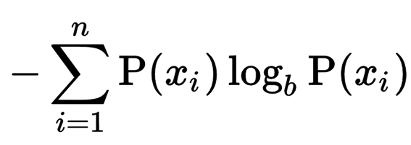
Entropy
Entropy is sometimes used to interpret aspects of player experience (e.g. Yannakakis 2005)
Common to use base 2 logs – then the unit is a Shannon (after the great Claude Shannon) (it means the number of bits of information gained on average on reading each symbol from a stream)
It measures the uncertainty of a system (high entropy means high uncertainty)
Optional reading exercise for later: find three papers that use entropy to measure game experience. How meaningful do you think it is?

Slide 12
Space Battle Example
Rotate and shoot:
2, 2, 2, 2, 2, 4, 2, 2, 2, 2, 2, 4, 2, 2, 2, 2, 2, 4, 2, 2, 2, 2, 2, 4, 2, 2, 2, 2, 2, 4, 2, 2, 2, 2, 2, 4, 2, 2, 2, 2, 2, 4,
Random
1, 2, 1, 2, 4, 2, 2, 2, 4, 0, 4, 0, 0, 2, 4, 2, 2, 4, 0, 2, 3, 4, 0, 1, 2, 4, 0, 2, 0, 0, 2, 4, 0, 0, 0, 1, 2, 0,
Exercise for lab:
Use the symbol frequencies as representative of the underlying symbol probabilities and calculate the action entropy of each of the above agents
Notes:
Offer good lab support for this exercise in case the students lack the maths to do it

Slide 13
Entropy: Beware!
Consider the two sequences:
111111111111111111111111…
101010101010101010101010…
If the first one were to continue like that it would have an entropy of zero.
What about the second one?
Notes:
Depends on the symbol used! If we said each symbol X was the word “10”, then the sequence is XXXXXX… and has an entropy of zero. Otherwise it has an entropy of 1 (max possible given an alphabet size of 2).

Slide 14
Applying Entropy – Visit Count
Entropy can be calculated for the states (most easily in a discretised state space) or locations visited by an agent.
Entries with zero visits should be ignored
0.0 * log(0.0) is defined as 0.0
x tends to zero faster than log(x)
But calculating this in Java would produce a NaN.

Slide 15
Applying Entropy – Visit Count
Suppose the agent visited these locations the indicated number of times
Divide each one by the total number of visits (in this case 100)
To form a probability vector
Then use the Shannon equation directly (but ignoring zero entries)
0
10
30
20
10
0
20
10
0.0
0.1
0.3
0.2
0.1
0.0
0.2
0.1

Slide 16
Who? Population of Players
Variability of score across population
(compare inter versus intra variations)
Skill-depth
Do good players reliably beat poor players?
Or is a random bot just as good as your super-duper MCTS agent?
Take care when measuring skill-depth: why?
Notes:
Why take care? Well, it could be that all the agents under test performed equally poorly, but a truly clever agent would shine. Therefore the presence of skill-depth is likely to be meaningful, but its absence does not prove a lack of skill-depth

Slide 17
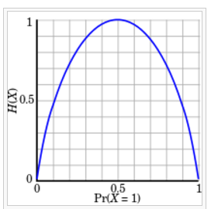
Entropy Diagram
For a binary channel, this is how it varies with P(X=1)
Maximum value of 1 Shannon (given that each symbol can be either 1 or 0)
Aim for the Goldilocks Zone – neither too high nor too low – but where???

Slide 18
Entropy Lab Exercise
Find the class entropy.EntropyTest
Experiment with different values of N and check the maximum per-symbol entropy possible given the value of N
Question:
How would you normalise the estimated Entropy so that it is always between zero and one?

Slide 19
Entropy Lab Exercise
Starting with the code on the next slide:
Run experiments with various players and various parameter settings
1. Can you tell players apart based on their entropy profile?
2. Implement other measures of player experience

Slide 20
test.GameEntropyLogTest
public class GameEntropyLogTest { public static void main(String[] args) { // todo: Play with different parameter values to observe effects on entropy // todo: How does entropy also vary depending on the players? // note: could set these up directly int[] params = {5, 4, 1, 2, 5, 20}; Constants.SHIP_MAX_SPEED = params[0]; Constants.THRUST_SPEED = params[1]; Constants.MISSILE_COST = params[2]; Constants.MISSILE_MAX_SPEED = params[3]; Constants.MISSILE_COOLDOWN = params[4]; Constants.SHIP_RADIUS = params[5]; int p1 = 2; // player list in GameTest.testedControllers int p2 = 2; System.out.format("Playing %s versus %s\n\n", GameTest.testedControllers[p1], GameTest.testedControllers[p2]); double[] x = playNAndMean(3, p1, p2); System.out.println(Arrays.toString(x)); StateObservationMulti.gameLogger.printReport(); } }

Slide 21
How skilful is a game? How may this be measured? We’ll now study the notion of Skill Depth

Slide 22
Measuring Skill Depth
Simple ways that are usually good enough
For single player games, look at range of scores (how tightly packed are they) – see GVGAI example
For two-player games, organise a set of matches between the players
Measure the Elo ratings

Slide 23
Elo Ratings – Two Player Games
Named after their inventor, Arpad Elo
Elo ratings are estimated from results of matches (win, loss, draw)
Variations assume either a normal distribution or a logistic distribution
That is: mapping of Elo difference to probability of a win

Slide 24
Elo Exercise
By adapting code from the web and / or reading the WikiPedia entry, write code to:
Calculate the probability of a win, given the Elo difference
Adjust the Elo rating of a player given:
The ratings of each player
The outcome
The value of K

Slide 25
Elo versus Win Rate
Elo ratings are good because they are simple to calculate and adjust over time
However, remember the main aim from our point of view is to measure skill depth
What we care about is whether “good” players can beat “bad” players
And if we’re in control of the league, we can just measure win-rates and use these as estimates of outcome probabilities
Question: why are they just estimates of outcome probabilities?
Notes:
Kind of obvious question: the reason they are just estimates is because we only have a finite sample of games to estimate from. As the size of the sample increase the standard deviation of the error decreases with a factor of 1/sqrt(n)

Slide 26
Beauty of Elo Model
Since Elo points difference dictates P(A beats B) we learn all we need to know just by considering the Elo rating of each player (and hence their difference in Elo points)
Whereas, if all you knew was:
P(A beats B) = 0.7
P(B beats C) = 0.8
What would this tell you about P(A beats C)?

Slide 27
Handling Intransitivities
Most popular games that people play are highly transitive
In other words, if A > B, and B > C, then A > C
Think Tennis (or your favourite sport) – mild intransitivities may exist among players of a very similar standard (though it’s hard to measure as players vary of time, and measurements are noisy)
But I’m never going to beat Roger Federer, even with my sly drop shots…
This is why Elo ratings work well

Slide 28
AI Agents and Intransitivities
In mature games such as Go, there is a range of strong AI agents that may be categorised by their Elo ratings
However, it is also possible to have AI agents that may be strong in some ways
But VERY WEAK in other ways
Likely to be true for the agents developed on this course (see Samothrakis et al)
Depends on how adaptive and how generally clever they are

Slide 29
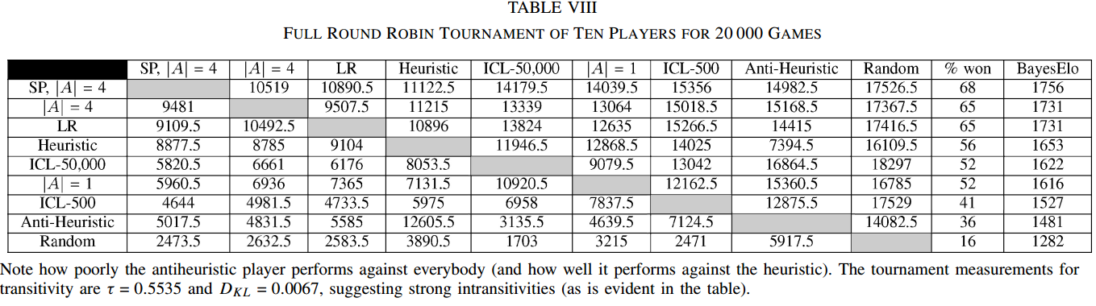
Table from Samothrakis et al (enter table and citation)

Slide 30
Dealing with Intransitivities
In the worst case there may be a strong pattern of agents being able to defeat other agents
But due to the averaging effect over all games played, the Elo ratings of each player are nearly identical
So Elo ratings would show little skill depth
Better in these cases to look at pair-wise probability of win rates
Strong differences in these may indicate an interesting game
It shows that some strategies have clear dominance over others

Slide 31
Close win rates among all players
Even this does not prove a lack of skill depth
It just means that the current set of players did not demonstrate it
Might still be possible for a super-smart player to come along and thrash all the current ones

Slide 32
Questions for Player Experience / Game Analytics to Answer
We made a change:
Can the difference be detected?
Hole detection / exploits?
Entropy changes?
More drama? (e.g. more flux in obvious measures?)
Can we learn a new strategy? And make better bots?
Can GUI frustration be measured?
Analysed touch events, near misses?
Bot Id Detection?

Slide 33
Statistical Player Profiling Space Battle Example: What to Measure
Raw
Action sequence analysis
Statistics such as entropy
Also: firing rate, thrust rate, rotation rate
Score trace (plot how score varies over time)
Death rate of player
Derived
Hit rate
Distance covered
Total angular rotation

Slide 34
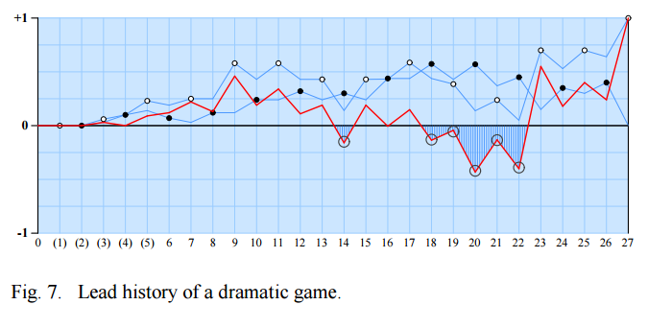
Aim for Drama (from Browne and Marie)

Slide 35
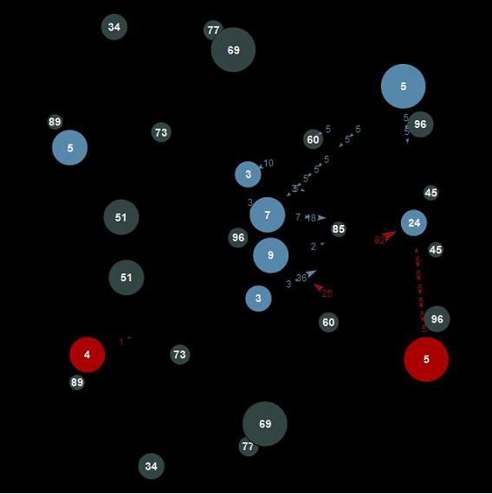
Planet Wars Data Analysis: Plotting “Piece” Difference

Slide 36
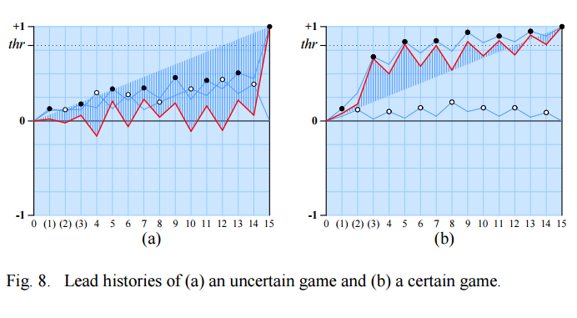
Which Category does Planet Wars Fit? (your homework is to play it)

Slide 37
Consider Planet Wars Example
Great game – see demo
BUT: a bit unbalanced
In that once a player gets ahead, there is a tipping point – a point of no return is reached
At which stage the game is boring – just a question of time before the lead player wins
Question:
Can we modify the rules to make it more balanced, but still exciting?
While maintaining skill depth?

Slide 38
Exercise
In groups:
Develop a set of measures to apply to “Asteroids / Space Battle Derivatives”
Implement some of them (aim for simple and effective)
Test their ability to detect differences in the game setup, and in the agents playing the game

